Slide 1

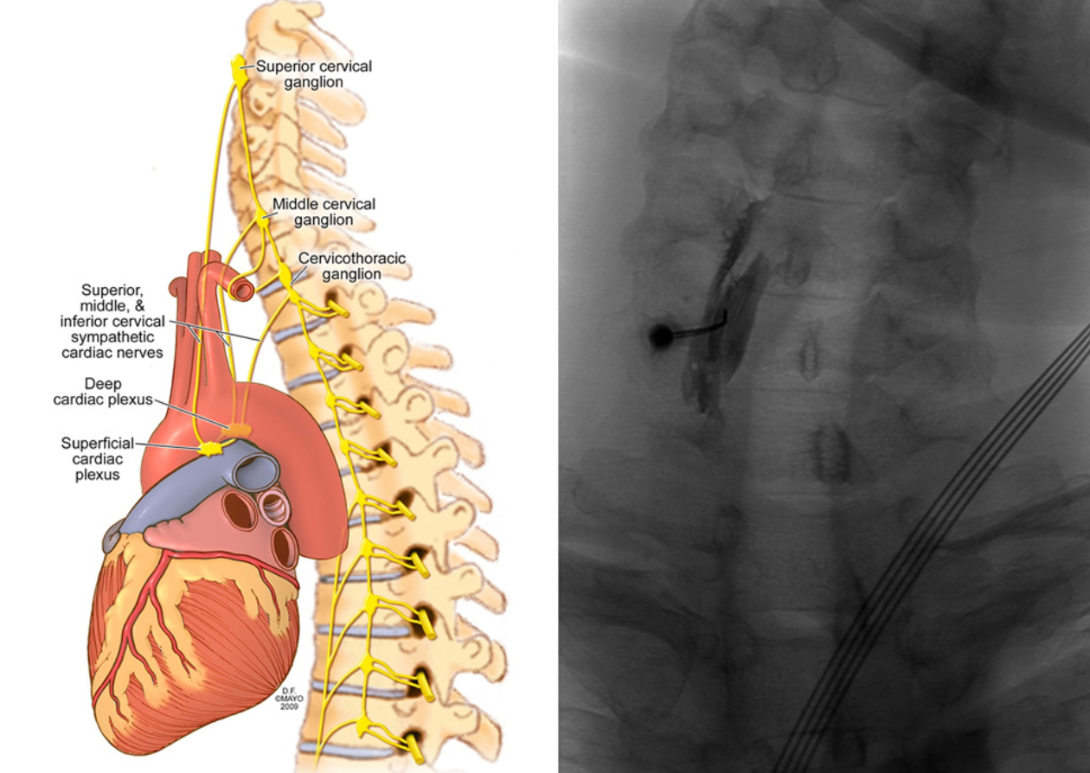
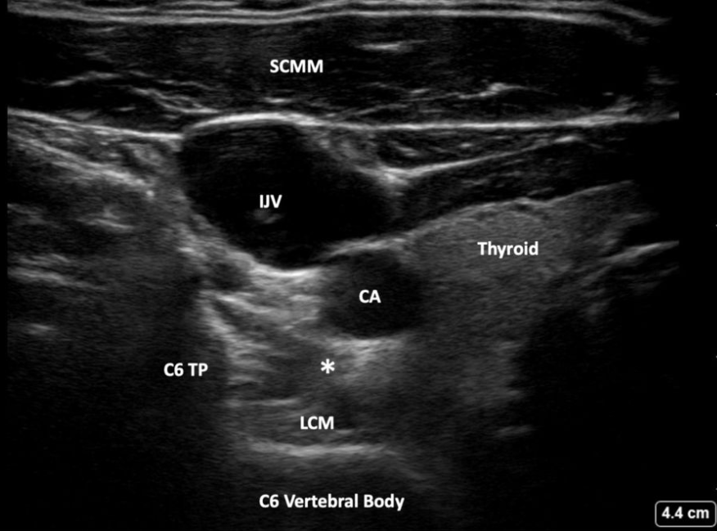
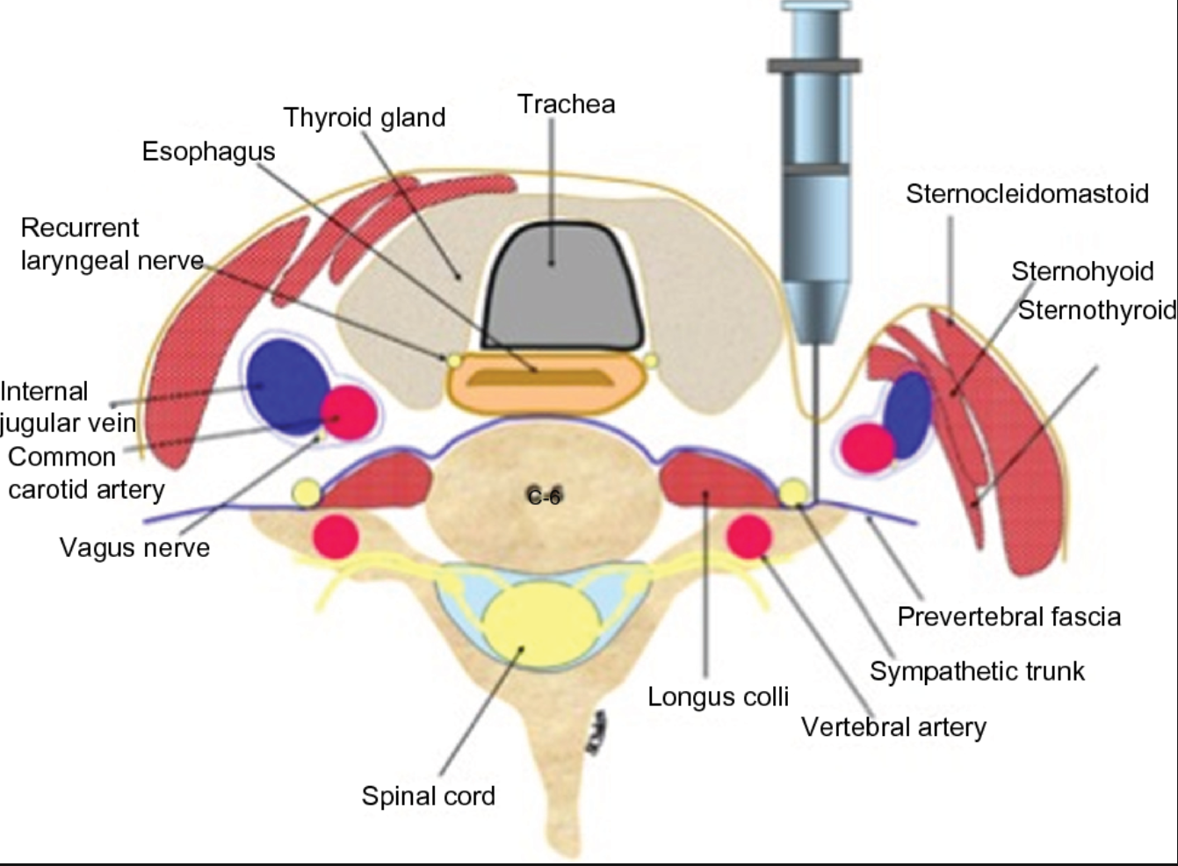
METHODS
For these procedures the following steps were taken: an intravenous line was placed, and the patient was transported to the procedure room, where heart rate, blood pressure, and oxygen saturation were continuously monitored. After positioning the patient supine with the neck extended to the left, fluoroscopy and ultrasound were used to identify the transverse process of C6, the sympathetic chain, and surrounding anatomy, followed by sterile preparation with chlorhexidine and infiltration of the needle entry point with 1% lidocaine. Using an in-plane ultrasound-guided technique, a 25-gauge spinal needle was advanced anterior to the longus colli muscle, and after negative aspiration, a solution containing 5 mL of 0.75% bupivacaine, 1 mL of 1% lidocaine, and 1 mL of dexamethasone was injected without complications. These exact sequence of steps were followed for one right-sided SGB and a subsequent left-sided SGB one week after followed by another left-sided SGB four months later.
Stellate Ganglion Block as a Novel Interventional Method to Treat Autonomic Dysautonomia in Chronic, Post-COVID Postural Orthostatic Tachycardia Syndrome: A Case Report
Thomas Oh, MD¹, Hamed Sadeghipour, MD¹
(1) Department of Anesthesiology and Critical Care, St. Louis University Hospital , St. Louis
RESULTS
Postural orthostatic tachycardia syndrome (POTS) is a chronic, autonomic disorder characterized by a dramatic heart rate increase upon standing, accompanied by orthostatic intolerance. Although this condition is relatively rare, affecting less than 1-2% of the developed population, effective therapies are limited, and available treatments provide modest relief to patients (1). The etiology of POTS has not been well documented in the literature, however, many factors may precipitate its onset such as trauma, pregnancy and viral infection. The debilitating nature of the symptoms handicaps patients, impairing their functional activities and drastically decreasing their quality of life (2). In the wake of the COVID-19 pandemic, survivors of COVID-19 may have a higher likelihood of developing POTS, highlighting the virus’s potential role in triggering long-term autonomic dysfunction (3). This case report highlights a unique presentation of post-COVID-19 POTS in a patient with recurrent COVID-19 infections and explores the promising therapeutic potential of stellate ganglion blocks (SGB) in managing the debilitating symptoms of this complex condition.
This patient is a 43 year old male who had contracted COVID-19 four times since 2020 despite receiving appropriate vaccinations and booster shots and developed POTS in 2024 with symptoms consisting of brain fog and exercise intolerance while being otherwise previously healthy before contracting COVID-19. His condition was refractory to pharmacologic intervention with pyridostigmine and his symptoms worsened to include anxiety that also led to diarrhea, leading his PCP to refer him to a chronic pain clinic for further interventional management of his POTS symptoms.
On subsequent follow up visits to the chronic pain clinic, this patient not only reported resolution of his gastrointestinal symptoms but also reported alleviation of his anxiety as well as complete resolution of his tachycardia with activity and exercise intolerance on his follow up visit about four months after his procedures. This case underscores the potential therapeutic role of stellate ganglion blocks in managing POTS, particularly in the context of post-COVID-19 dysautonomia.
POTS, which is characterized by autonomic dysfunction, can significantly impact quality of life, and its association with long COVID has brought increased attention to the need for effective treatments. Stellate ganglion blocks have traditionally been used for conditions such as complex regional pain syndrome and chronic pain. There are few indications for SGB outside of pain related sequelae, but the literature shown SGB’s utility in modulating sympathetic overactivity, which may play a role in POTS pathophysiology (4). There is sparse evidence of SGB’s in treating POTS symptoms in long COVID patients although their efficacy has been documented in recent years (5). In this patient, who developed POTS after multiple COVID-19 infections, SGB led to an improvement in symptoms, suggesting a potential pathway for symptom relief in similar cases while also demonstrating a unique case of a patient’s gastrointestinal symptoms and psychiatric symptoms also resolving as a result of SGB. While the precise mechanisms remain under investigation, this case adds to the growing body of evidence supporting the use of SGB as a novel intervention for autonomic disorders associated with long COVID. Further studies are needed to establish the long-term efficacy and safety of SGB in this patient population.
INTRODUCTION
DISCUSSION
CASE REPORT
Fluoroscopic view of C6 target from an anterior perspective with a needle trajectory aimed slightly medial to avoid the carotid artery and trachea.
Typical ultrasonographic view of major blood vessels and landmarks when performing a SGB. The * denotes the location of the stellate ganglion below the carotid artery (CA). (IJV- internal jugular vein, LCM- longus colli muscle, TP- transverse process, SCMM- sternocleidomastoid muscle)
Cross section of stellate ganglion block at the level of C6, with major landmarks and blood vessels denoted.
References
Fedorowski A. Postural orthostatic tachycardia syndrome: clinical presentation, etiology and management. J Intern Med. 2019;285(4):352-366. doi:10.1111/joim.12852
Zhao S, Tran VH. Postural Orthostatic Tachycardia Syndrome. In: StatPearls. Treasure Island (FL): StatPearls Publishing; August 7, 2023.
Mallick D, Goyal L, Chourasia P, Zapata MR, Yashi K, Surani S. COVID-19 Induced Postural Orthostatic Tachycardia Syndrome (POTS): A Review. Cureus. 2023 Mar 31;15(3):e36955. doi: 10.7759/cureus.36955. PMID: 37009342; PMCID: PMC10065129.
Feigin G, Velasco Figueroa S, Englesakis MF, D'Souza R, Hoydonckx Y, Bhatia A. Stellate ganglion block for non-pain indications: a scoping review. Pain Med. 2023;24(7):775-781. doi:10.1093/pm/pnad011
Liu LD, Duricka DL. Stellate ganglion block reduces symptoms of long COVID: a case series. J Neuroimmunol. (2022) 362:577784. 10.1016/j.jneuroim.2021.577784
Notes:
Notes:
In Powerpoint, click View > Guides
Keep text within gutter guides.
Author list: Don’t split names onto two lines (e.g., “Jimmy [break] Smith”). If that happens, use a new line, unless you need the space. Bold the first names of anybody who’s presenting in person.
Intro/methods/result: Do not drop below font size 28, but if you have extra space, jack up the font size until the space is full.
Do not use color in the sidebars except in graphs/figures. It’ll pull attention from the center and slow interpretation for passersby.

