Slide 1
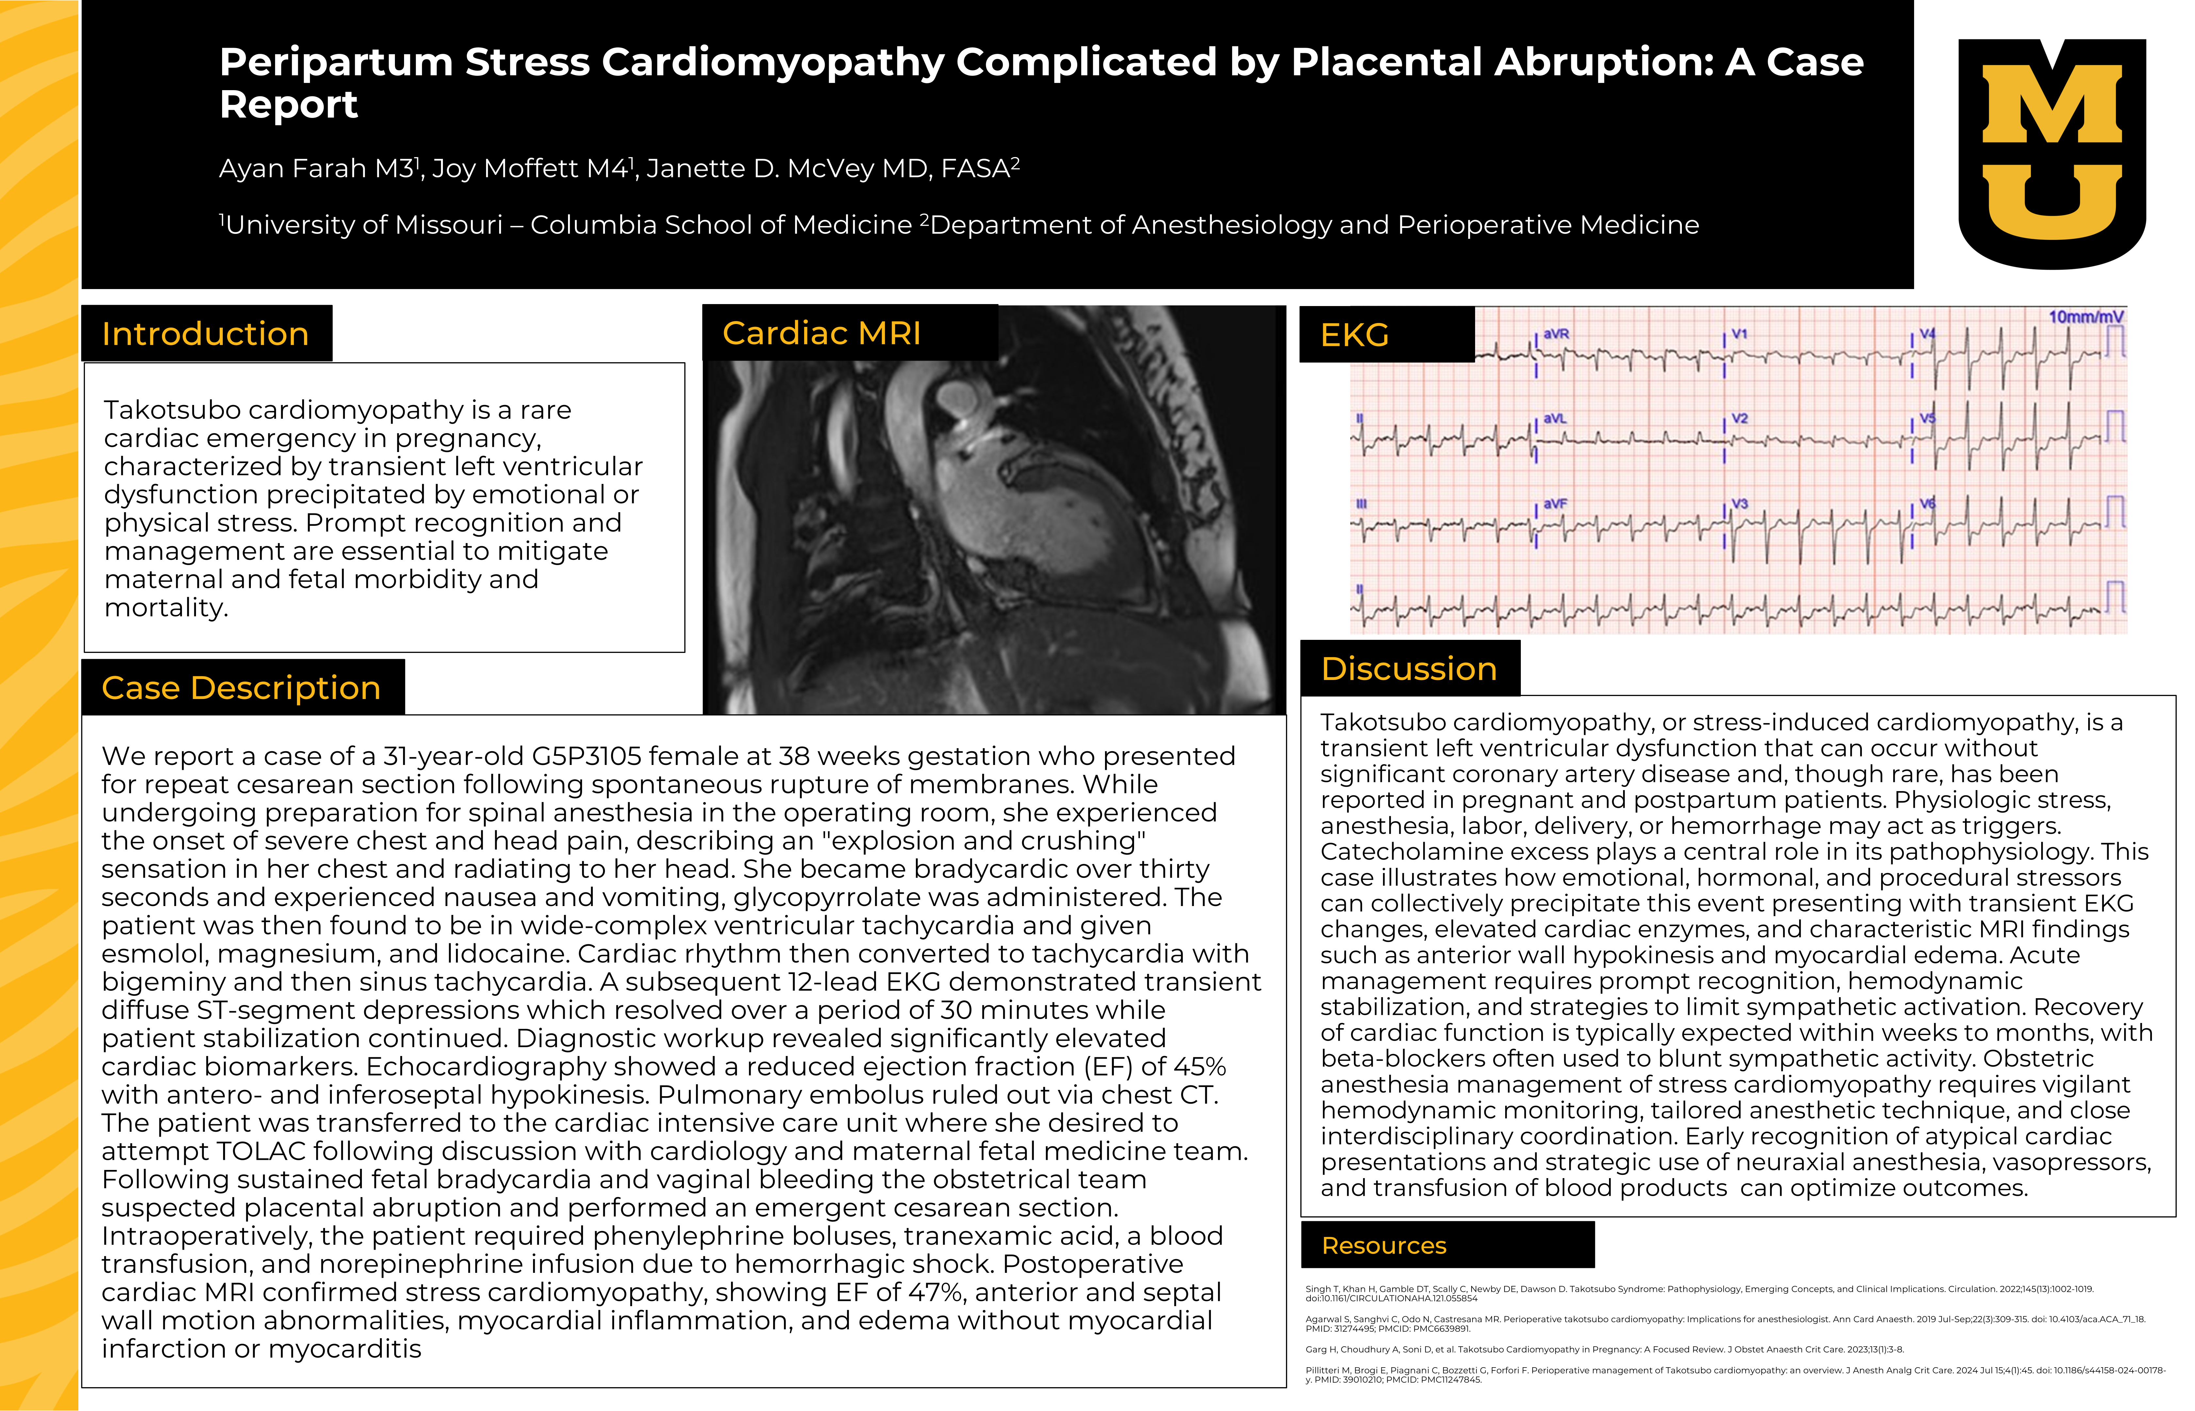

Slide 2
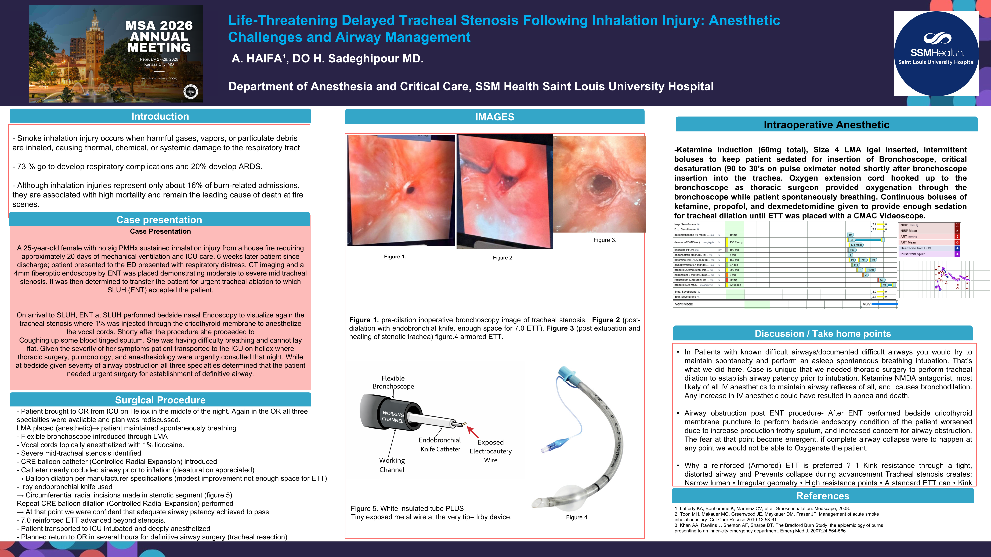

Slide 3
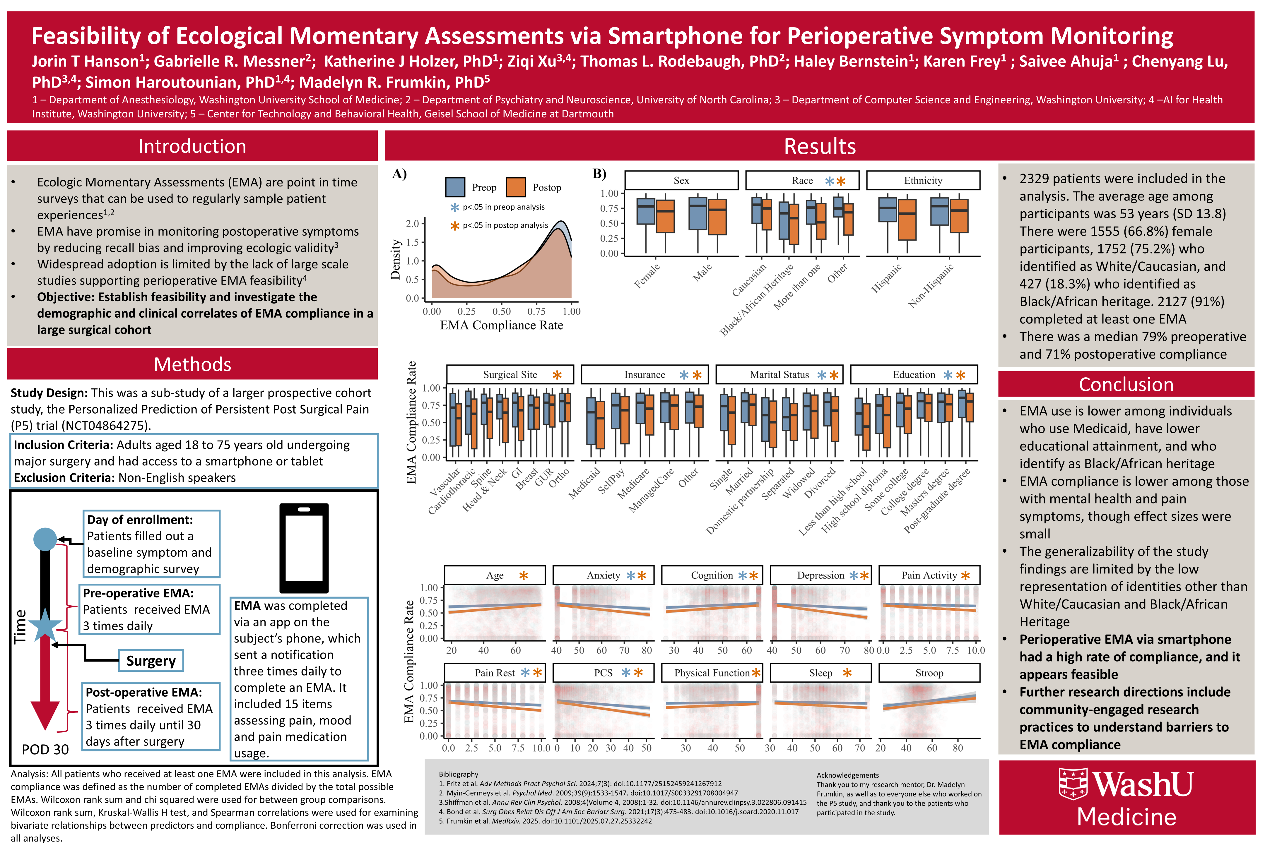

Slide 4
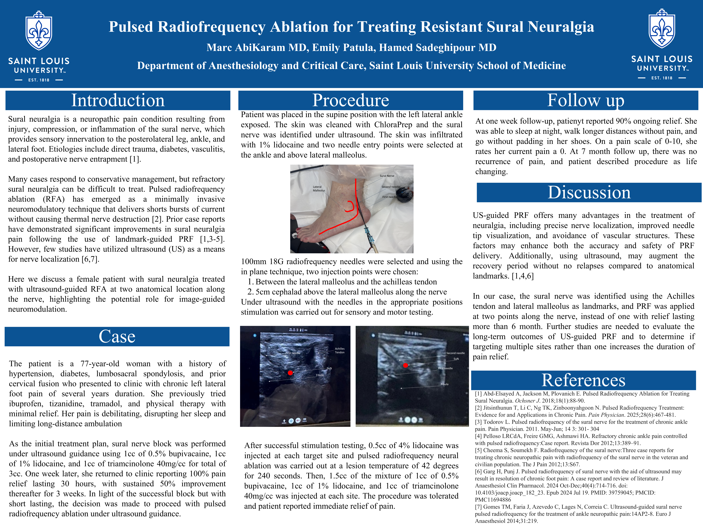

Slide 5
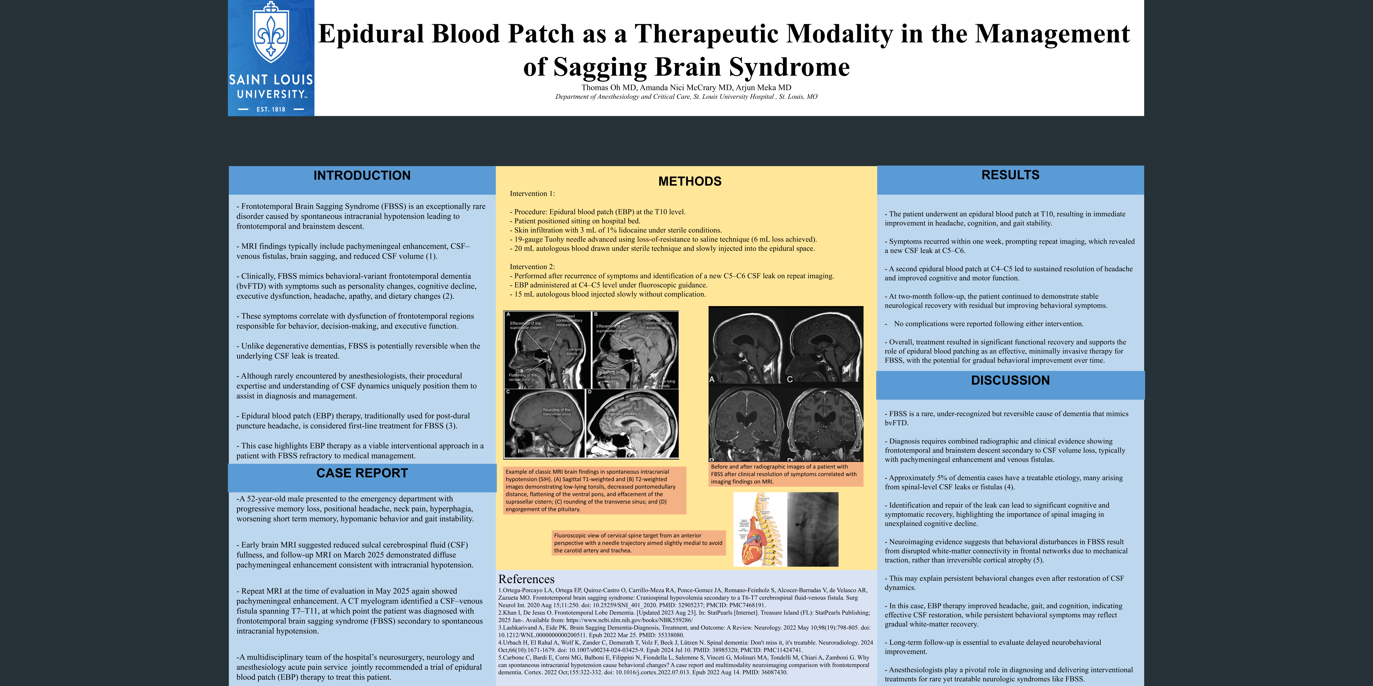

Slide 6

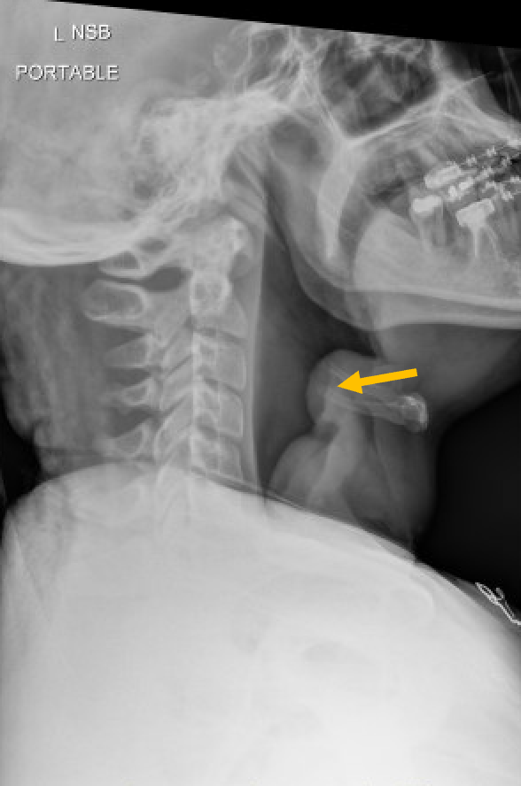
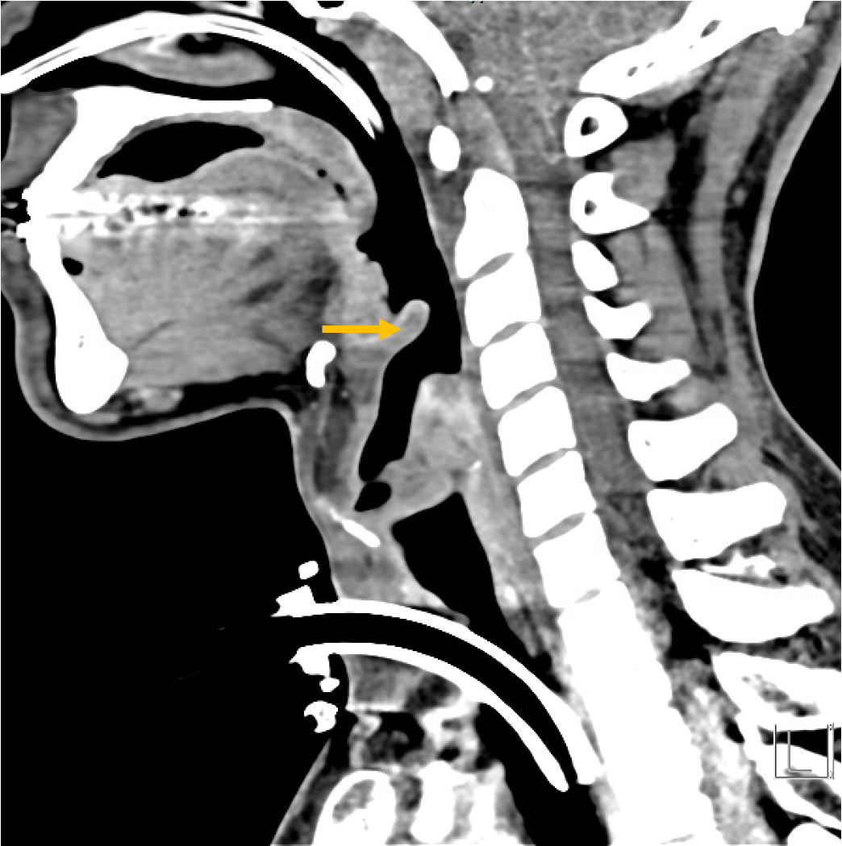
Menthol Vape-Associated Epiglottitis in a Chronic Cannabis Smoker: A Case Study
John A. Merlo MD, Thomas Koch, MS4, Hamed Sadeghipour MD
Anesthesiology and Critical Care, SSM Saint Louis University Hospital, St. Louis, MO, USA
Introduction:
Epiglottitis is an acute inflammatory condition of the supraglottic structures, most notably the epiglottis, that can rapidly progress to airway obstruction. The incidence of adult epiglottitis has increased in recent years to approximately 3 in 100,000, with a mortality rate of 1%.¹ While traditionally caused by Haemophilus influenzae type B and other bacterial pathogens, especially in pediatric populations, the incidence of non-infectious causes is rising. With the widespread adoption of e-cigarettes and vape pens, inhalational exposure to chemical irritants is now recognized as a possible cause of upper airway inflammation. Volatile compounds found in vape aerosols—including propylene glycol, glycerin, flavoring agents, and adulterants like menthol—may provoke mucosal irritation and edema.² We report a case of acute epiglottitis in a chronic cannabis smoker, temporally associated with menthol vape escalation with no evidence of infection.
Case Report:
Discussion:
This case adds to a growing body of literature implicating vaping as a potential cause of acute, non-infectious epiglottitis. Several case reports have documented patients—particularly young adults—presenting with characteristic symptoms after recent vaping activity, often with negative infectious workups.^{3, 4} Furthermore, a 2022 scoping review emphasized significant knowledge gaps regarding the respiratory toxicity of non-nicotine e-liquid constituents. Many chemicals inhaled during vaping—such as propylene glycol, glycerin, thermal degradation products, and potential adulterants like menthol—remain largely unregulated and untested for their effects on upper airway tissues.² These cases, along with toxicologic studies of vaping aerosols, suggest that chemicals such as acrolein, menthol, and other aldehydes may directly injure respiratory epithelium.
The findings on nasopharyngoscopy in alignment with his worsening clinical status also dictated the escalation of therapy toward intubation. A recent systematic review compiling studies from 1980 to 2020 showed an overall airway intervention rate of 15.6%.¹ However, guidelines on airway management specific to adult epiglottitis remain unclear. This is one reason for involving airway specialists in these cases, which could include ENT, anesthesiologists, or intensivists. It is also recommended that these patients be observed in the ICU regardless of whether they are intubated, have a tracheostomy, or are being closely monitored with their natural airway.⁵ In this case, tracheal intubation was attempted first, likely because it is less invasive. However, this was aborted after concern for failure using fiber optics. This concern turned out to be supported by data, as the failed intubation rate is high at 4.2%.¹
A 34-year-old male with a history of hypertension, daily marijuana and vape pen use presented with acute epiglottitis. On the day of presentation, he reported experiencing shortness of breath and difficulty swallowing. He went to urgent care that morning where he received intramuscular epinephrine and solumedrol without significant improvement. His shortness of breath worsened, and he developed a sensation of feeling as if his throat was closing, leading to his transfer to the emergency department (ED). Social history revealed smoking of one joint of marijuana daily. He also noted purchasing a menthol disposable vape pen over the counter containing 6mg nicotine two days prior to the incident. He stated he increased the frequency of the use due to stress at work.
Upon admission, the patient was placed on a non-rebreather mask with an oxygen saturation of 100%. Initial laboratory findings included potassium at 3.2, bicarbonate at 20, phosphorus at 1.9, lactate at 3.8, and a white blood cell count of 14.6. A lateral neck x-ray was obtained and showed an enlarged epiglottitis and overdistended hypopharynx (Figure 1.)
His respiratory status worsened, with increasing difficulty protecting his airway. He received racemic epinephrine and dexamethasone, leading to mild improvement. However, due to persistent airway compromise, consultations with ENT and anesthesia were obtained. Bedside nasopharyngoscopy revealed significant epiglottic swelling with airway narrowing.
The anesthesia team was present at the bedside, and the trauma room was equipped with a video laryngoscope with MAC 4 and D blades, a bougie, a fiberoptic scope, an intubating Laryngeal Mask Airway (LMA), various sizes of endotracheal tubes, and a cricothyroidotomy kit as a precaution. Additionally, appropriate medications were prepared. The anesthesia team discussed the airway management plan with the emergency medicine, ENT, and trauma surgery teams. The initial plan was to maintain spontaneous ventilation while attempting visualization with video laryngoscopy. The patient was sedated with 2 mg of Versed but experienced discomfort and coughing with positioning of the D blade. Subsequently, 50 mg of ketamine was administered and titrated while ensuring he remained spontaneously breathing.
A grade 3 view was obtained, demonstrating an edematous epiglottis with a narrow opening. The decision was made to proceed with fiberoptic intubation using a bougie to secure the tracheal airway. However, as the fiberoptic scope was advanced, significant airway narrowing was observed with any manipulation. Given the high risk of failed intubation, Anesthesia team instructed trauma surgery to prepare for an emergent cricothyroidotomy, followed by an operating room tracheostomy.
During the tracheostomy, the patient remained hemodynamically stable. He was then transferred to the medical intensive care unit (MICU) and started on ceftriaxone (CTX) and vancomycin. His methicillin-resistant Staphylococcus aureus (MRSA) PCR test was negative, and additional testing ruled out bacterial causes. The etiology of his epiglottitis was determined to be thermal injury secondary to vape pen use.
In the subsequent days following tracheostomy placement, the patient was transitioned to a tracheostomy collar with the cuff down. Bedside laryngoscopy continued to show epiglottic swelling with concern for purulence. A CT scan of the neck revealed soft tissue thickening at the upper esophageal sphincter and left greater than right aryepiglottic folds, with mild to moderate airway narrowing. The epiglottitis was shown to be improved without significant thickening (Figure 2.). Repeat laryngoscopy also showed improvement in swelling.
After seven days with the tracheostomy, the patient tolerated capping trials without desaturation. On day 10, the tracheostomy was successfully removed without complications. The patient was discharged with appropriate follow-up and education on airway precautions and smoking cessation.
Conclusion:
There is a need for more research involving management of epiglottitis, as limited data exist to aid in airway management. This case demonstrates the importance of using clinical judgement and taking a social history, as airway compromise can occur suddenly. This case underscores the importance of considering vaping-associated chemical injury in the differential diagnosis of acute epiglottitis. As vaping becomes increasingly prevalent, especially among younger populations, awareness of its potential airway complications is critical to timely diagnosis and intervention.
References:
1. Booth, A. W. G., Pungsornruk, K., Llewellyn, S., Sturgess, D., & Vidhani, K. (2024). Airway management of adult epiglottitis: a systematic review and meta-analysis. BJA open, 9, 100250. https://doi.org/10.1016/j.bjao.2023.100250
2. Strongin RM. E-cigarette chemistry and analytical detection. Tob Induc Dis. 2022;20:20. doi:10.18332/tid/146498
3. Bozella MJ, Shorter E, Loftus PA. Epiglottitis associated with intermittent e-cigarette use. Pediatrics. 2020;145(3):e20192723. doi:10.1542/peds.2019-2723
4. Khorrami A, Khorrami MA, Gheriani H. Vaping-induced acute epiglottitis: a case report. Int J Emerg Med. 2023;16(1):56. Published 2023 Sep 5. doi:10.1186/s12245-023-00532-x
5. Dowdy, R. A. E., & Cornelius, B. W. (2020). Medical Management of Epiglottitis. Anesthesia progress, 67(2), 90–97. https://doi.org/10.2344/anpr-66-04-08
Figure 1. Lateral neck x-ray collected prior to intervention. Orange arrow points to classic thumbprint sign consistent with epiglottitis.
Figure 2. Sagittal CT neck showing no abnormal enhancement or significant thickening of the epiglottitis. Orange arrow points to epiglottitis and improved swelling in comparison to the x-ray collected one week prior.

Slide 7
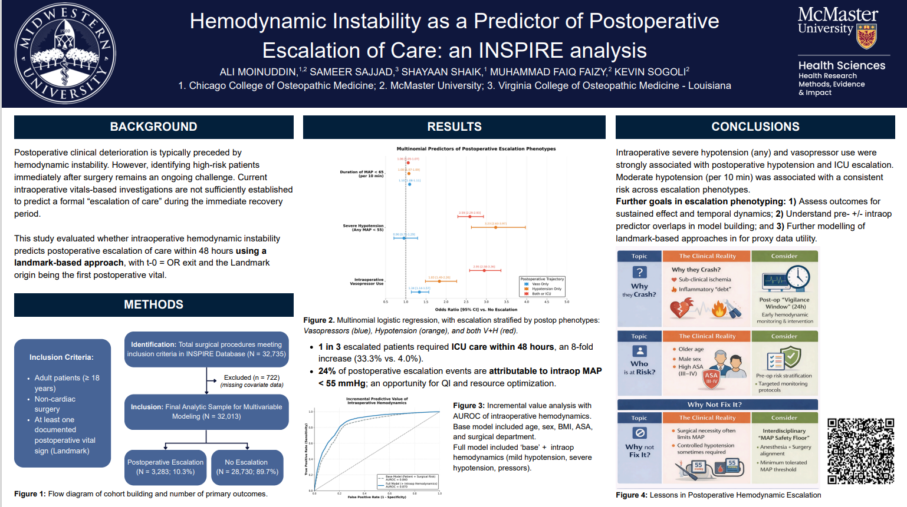

Slide 8
