Slide 1

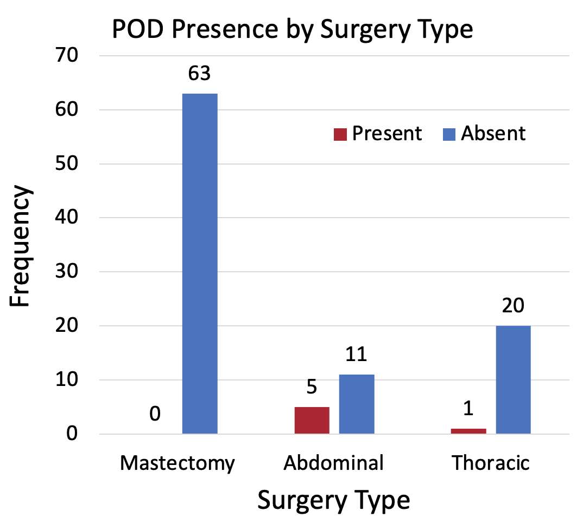
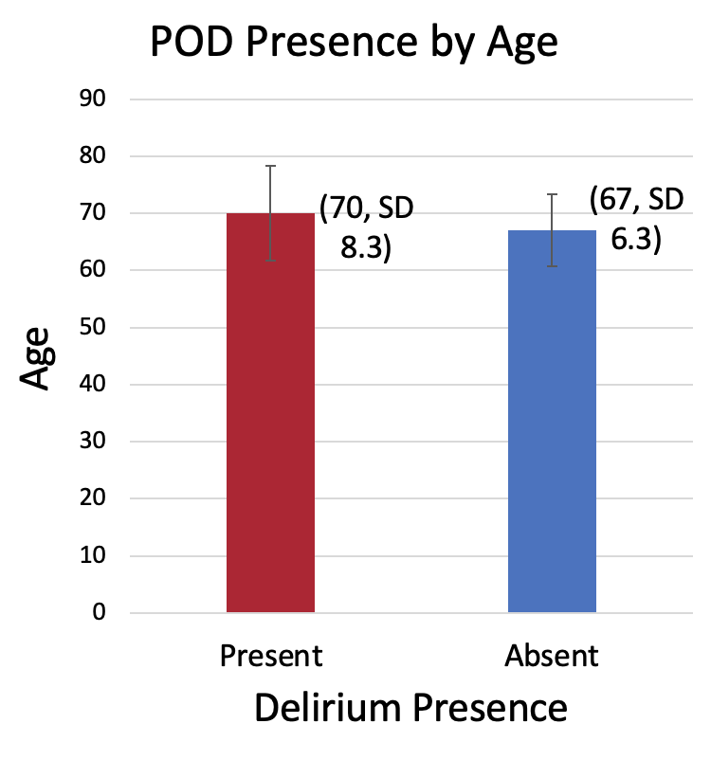
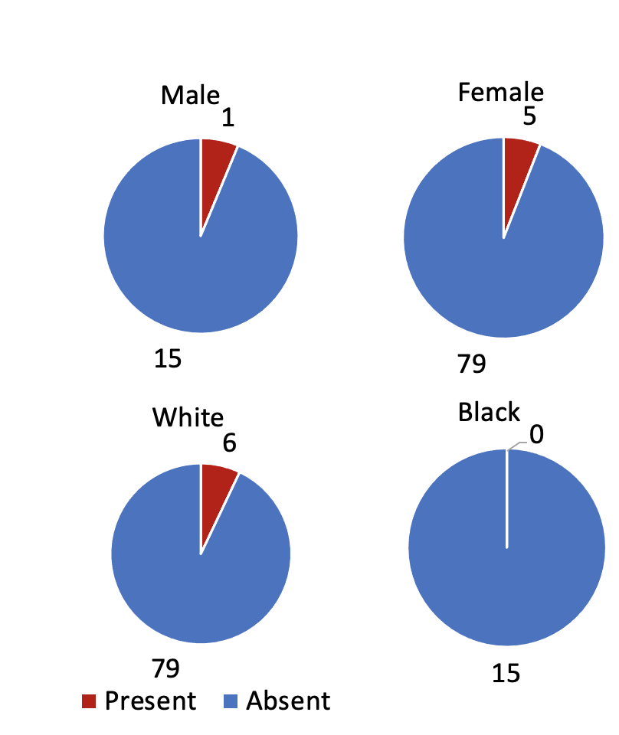


Perioperative Mental Health Intervention and Post-Operative Delirium in Oncologic Surgery Patients
Jorin T Hanson¹; Joanna Abraham, PhD¹; Theresa A Cordner¹; Michael S Avidan, MBBCh¹; Eric J Lenze, MD²; Katherine J Holzer, PhD¹
1 – Department of Anesthesiology, Washington University School of Medicine; 2 – Department of Psychiatry, Washington University School of Medicine
Introduction
Results
Post operative delirium (POD) occurs more frequently in older adults with anxiety and or depression¹
Patient distress during the perioperative period strongly predicts incidence of POD²
Perioperative mental health interventions can improve mental health status during the perioperative period^{3,4}
Objective: Explore the demographic characteristics of POD incidence in a surgical cohort and investigate the effects of perioperative mental health interventions on POD
POD Presence by Demographic Group
Sex at Birth
Methods
Race
Study Design: This was a sub-study of a larger single site randomized controlled trial (NCT05685511).
Data Collection and Analysis: Demographic data was collected through pre-study surveys. POD was assessed after the hospital admission through the retrospective chart review method CHART-DEL.⁶ Descriptive statistics were used to calculate the incidence of delirium and summarize demographic characteristics of the cohort.
Inclusion Criteria: Participants must be 1) $≥$60 years of age 2) scheduled for oncological surgery 3) have clinically significant anxiety or depression symptoms based on a PHQ-ADS⁵ score $≥$10
Exclusion Criteria: 1) Cannot speak English, 2) have severe cognitive impairment as defined by Short Blessed Test score of $≥$10, 3) have acute suicidal features
Treatment | Present | Absent
Intervention | 2 | 50
Enhanced Usual Care | 4 | 44
Conclusion
Perioperative mental health interventions may reduce POD in older cancer surgery patients with anxiety and/or depression, but current evidence is inconclusive.
POD was more prevalent in thoracic and abdominal surgery patients, absent in breast surgery patients, and more frequent in those receiving enhanced usual care.
Limited pre-operative intervention engagement by POD-positive participants indicates future research is needed on the relationship between intervention engagement and POD risk.
There is potential for integrating medication optimization and wellness programs with perioperative care.
Further research is needed to test the effect of mental health interventions on POD, tailor intervention strategies, and explore the mechanistic link between perioperative mental health and POD prevention
Included subjects (n=100)
Among the 6 POD positive patients’ surgeries, 3 received hepatectomies, 2 received pancreaticoduodenectomies, and 1 received an esophagectomy.
Among the 2 POD positive cases in the intervention group, one patient received no intervention sessions. The other received one session.
The average number of preoperative wellness sessions was 1.02 (SD=1.4) among those in the intervention group with no POD.
Intervention Group (n=52)
Enhanced Usual Care Group (n=48)
Medication Optimization
Deprescribing inappropriate medications
Optimizing doses
Wellness Program
Based on behavioral activation and care coordination
Received mental health resources (educational pamphlets)
References
1. Ren et al. Clin Interv Aging. 2021;16:549-557
2.Wada et al. World J Surg. 2019;43(1):134-142
3. Zhao et al. Medicine (Baltimore). 2021;100(31):e26736.
4. Dao et al. J Thorac Cardiovasc Surg. 2011;142(3):e109-e115.
5. Kroenke et al. Psychosom Med. 2016;78(6):716-727.
6. Krewulak et al. J Am Geriatr Soc. 2021;69(4):1027-1034
Acknowledgements
Thank you to my research mentor, Dr. Katie Holzer, as well as to everyone else who worked on the CPMH study, and thank you to the patients who participated in the study.

