Slide 1

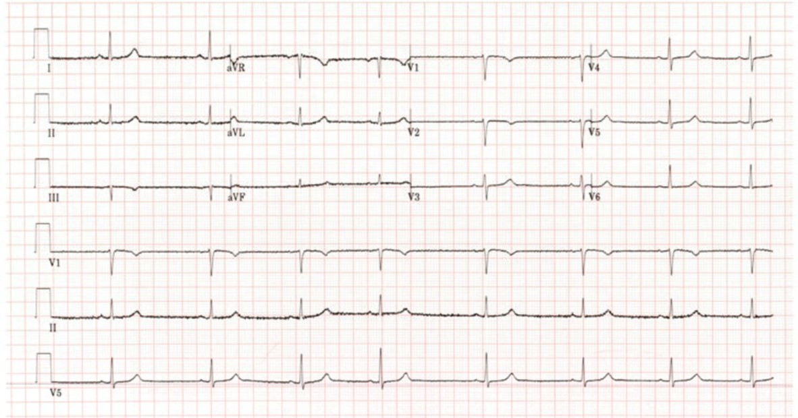
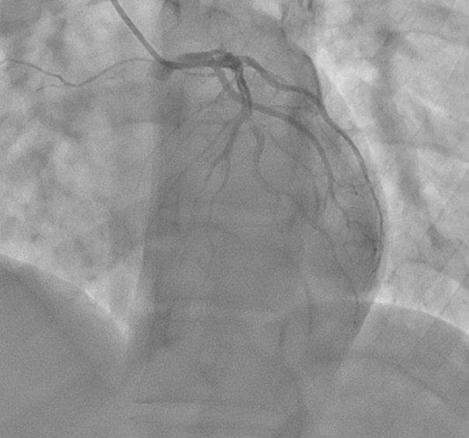
Spontaneous Coronary Artery Dissection: Review of Current Management Strategies
Alexis DeTienne B.S^{.1,} Brooke Scieszinski MD², Jared Olson DO², Paige Spencer², Bradford Cardonell MD²
¹School of Medicine, University of Missouri-Columbia; ²Department of Anesthesiology and Perioperative Medicine, University of Missouri-Columbia
Introduction
Discussion
Spontaneous coronary artery dissection (SCAD) is a rare, non-atherosclerotic cause of acute coronary syndrome (ACS) that predominantly affects women
SCAD accounts for 1-4% of ACS cases and up to 35% of myocardial infarctions (MI) in women under 50
Leading cause of pregnancy-associated MI with the left anterior descending artery (LAD) often involved
Diagnosis is challenging due to variable presentation and complications like arrhythmias, reduced ejection fraction, and sudden death
Management often relies on conservative therapy, but severe cases may require circulatory support or surgery
There are challenges in managing SCAD, particularly in peripartum women, where its rare occurrence and variable presentation often contribute to underdiagnosis. Early recognition is crucial to prevent rapid progression to cardiogenic shock.
The typical SCAD patient is a young, otherwise healthy, white female in her 40-50s with no previous significant atherosclerotic or cardiovascular risk.
EKG findings often find ST elevation and increased troponin levels with the initial LV EF has been reported to often be around 50%.
Cardiogenic shock occurs in only 2-5% of all SCAD cases and there is current limited literature on this and the uses of mechanical circulatory support.
Most cases are diagnosed utilizing gold standard coronary angiography due to being readily available at most hospitals and its preference in early management of ACS.
Cases that involve the mid to distal vessels are managed conservatively with favorable outcomes using only medications such as beta blockers, aspirin, and an ADP antagonist/clopidogrel. These cases often show evidence of late vessel healing in the following weeks-months.
Involvement of more proximal vessels or a hemodynamically unstable patient often use a more invasive approach involving stenting or CABG surgery, with extensive dissections leading to the consideration of heart transplantation.
The in-hospital mortality rates of SCAD are low, however, up to 14% of cases treated conservatively require subsequent revascularization via PCI or CABG.
PCI and less conservative management strategies have shown up to 50% technical failure in patients with SCAD compared to atherosclerotic ACS.
These findings hope to invite discussion to develop clear guidelines on when invasive compared to conservative management should be pursued to improve the overall treatment of SCAD.
Figure 1 Sinus bradycardia with findings consistent with anterior NSTEMI noted in leads II, V1, V2
Case
A 33-year-old woman, 8 days post c-section, presented with chest pain radiating to her arms and neck, dizziness and shortness of breath. Her history included prior c-sections, anxiety, GERD, and migraines, but no cardiovascular disease or risk factors.
Initial workup revealed new-onset bradycardia, anterior ST depressions on EKG, and elevated troponin (191.4 pg/mL). CT angiography ruled out pulmonary embolism and aortic dissection. TTE revealed an EF of 63%. As troponins trended up, aspirin was given. Coronary angiography revealed a right-dominant system with spontaneous coronary artery spiral dissection extending from the left main to the LAD and LCx. She developed severe chest pain, hypotension, and cardiogenic shock, requiring mechanical support with an intra-aortic balloon pump, which was later upgraded to an Impella CP.
Due to instability and significant ST elevations, the patient was emergently transferred for urgent CABG. Intraoperative TEE showed hypokinesis of the basal anterior wall, akinesis of mid-papillary, apical anterior, and lateral walls, and an EF of 15-20%. The RV was mildly enlarged with RVSP of 54 mmHg and CVP of 28 mmHg. Intraoperative findings revealed LCA dissection extending to the apex with intermittent partial thrombosis throughout. Coronary bypass was not attempted due to the extensive dissection, and an Impella 5.5 was placed. The patient was transferred for heart transplant consideration. Over weeks, she was weaned off inotropic support, with EF improving to 45% at 15 days post-op and near-normal at 30 days. GDMT was initiated during this time, including aspirin, metoprolol, Farxiga, Entresto, spironolactone, and furosemide. Imaging showed healing of the dissection, and she was discharged on beta-blockers and aspirin.
The following 3-month course was uneventful. 3 months after discharge she was diagnosed with fibromuscular dysplasia and continues to receive multidisciplinary care with cardiology, neurology, and rheumatology. In our case the patient’s multivessel and proximal vessel involvement and rapid decline into cardiogenic shock led to the attempted CABG procedure, abortion of CABG, and transferal to a heart transplant capable facility. While being treated conservatively awaiting a viable organ for transplant, the patient’s EF increased and symptoms subsided, allowing her to return home without further invasive intervention.
Conclusion
The patient’s multivessel and proximal vessel involvement alongside rapid decline into cardiogenic shock led to attempted and aborted CABG and transfer to a heart transplant capable facility.
Conservative management may allow time for the previously described healing of coronary vessels without invasive repair.
Recognizing and accurately diagnosing SCAD is crucial for optimal patient health outcomes.
This case demonstrates the power of conservative management with synchronous use of ventricular support devices in severe dissections as a viable alternative in SCAD cases while awaiting definitive treatment.
Acknowledgements and References
Figure 2 Coronary angiography in LAO Cranial projection, demonstrating coronary dissection extending from the left main into the proximal LAD and diagonal artery
This project is supported by the University of Missouri School of Medicine and the Department of Anesthesiology and Perioperative Medicine
Nishiguchi T, Tanaka A, Ozaki Y, Taruya A, Fukuda S, Taguchi H, Iwaguro T, Ueno S, Okumoto Y, Akasaka T. Prevalence of spontaneous coronary artery dissection in patients with acute coronary syndrome. Eur Heart J Acute Cardiovasc Care 2016;5:263–70. https://doi.org/10.1177/2048872613504310.
Elkayam U, Jalnapurkar S, Barakkat MN, Khatri N, Kealey AJ, Mehra A, Roth A. Pregnancy-associated acute myocardial infarction: a review of contemporary experience in 150 cases between 2006 and 2011. Circulation. 2014;129:1695-1702. doi: 10.1161/CIRCULATIONAHA.113.002054.
Hayes SN, Kim CESH, Saw J, Adlam D, Arslanian-Engoren C, Economy KE, Ganesh SK, Gulati R, Lindsay ME, Mieres JH, Naderi S, Shah S, Thaler DE, Tweet MS, Wood MJ. Spontaneous coronary artery dissection: Current state of the science: A scientific statement from the American Heart Association. Circulation 2018;137:e523–57. https://doi.org/10.1161/CIR.0000000000000564.
Ravipati H, Rodrigues S, Rao S, Hatharaliyadda B, Junia C. The Young Heart Tears Easily Apart: A Case Report of Spontaneous Coronary Artery Dissection. Cureus 2021;13:e15590. https://doi.org/10.7759/cureus.15590.

